Slide 1
docker

Slide 2
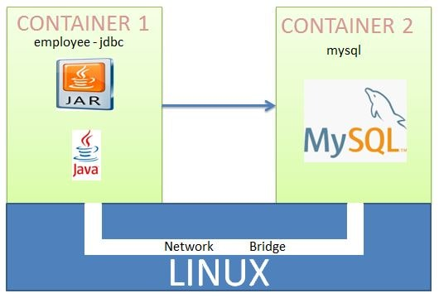
Deploy Spring Boot + MYSQL Application to Docker

Slide 3
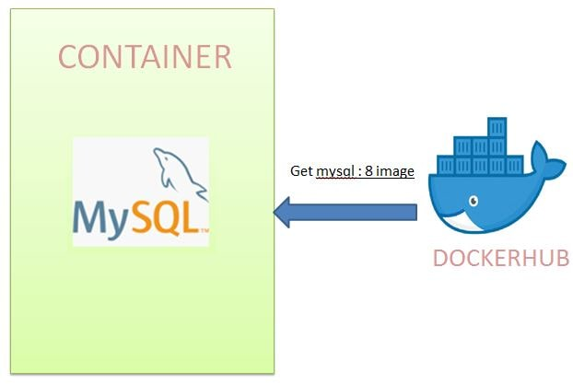
Deploy Spring Boot + MYSQL Application to Docker
Step-1
Create MySQL Image as Docker Image from Docker Hub
Start docker:
systemctl start docker
--- make docker network , named as country-mysql
docker network create country-mysql
docker network ls
use the image provided by dockerhub to run as container with following information for container
a. name of the mysql container
b. What should be the password for MYSQL
c. We want to create the Database named bootdb.
d. specify the network employee-mysql on which this container should be created.
e. start the container in detached mode.
docker container run --name mysqldb --network country-mysql -e MYSQL_ROOT_PASSWORD=root -e MYSQL_DATABASE=countrydb -d mysql:8

Slide 4
Deploy Spring Boot + MYSQL Application to Docker
Step-1
Next let us check if container has started correctly using logs command.
docker container ls
-- check mysql container id & then its log
docker container logs -f <container id>

Slide 5
Deploy Spring Boot + MYSQL Application to Docker
Step-1
Using the exec command we can also inspect if the database named countrydb is created successfully.
docker container exec -it <container id /name> bash
mysql# mysql -uroot -proot
show databases;
use countrydb;
create table country (code varchar(10) not null primary key , name varchar(10));
insert into country values ('IN','India'),('US','United');
select * from country;

Slide 6
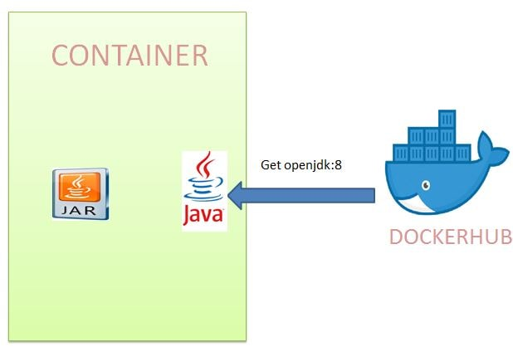
Deploy Spring Boot + MYSQL Application to Docker
Step-2
Create a spring boot web application with Data JPA
Dependencies:
Spring Web
Spring Data JPA
MySql

Slide 7
Deploy Spring Boot + MYSQL Application to Docker
Step-2
----Next we will modify the application.properties in the Spring Boot application to make use of the mysql container name i.e. mysqldb instead of localhost
spring.datasource.url=jdbc:mysql://mysqldb/countrydb
spring.datasource.username=root
spring.datasource.password=root
spring.datasource.platform=mysql
spring.datasource.initialization-mode=always
generate jar as maven build command : package
Right click on eclipse project – Run As – maven Build – Under Goals , write “package” --Ok

Slide 8
Deploy Spring Boot + MYSQL Application to Docker
Step-3
===== Under linux env,
make a folder : restsql
#pwd
/home/centos
#mkdir restsql
#cd restsql
#nano Dockerfile
From openjdk:8
copy ./countryrestapp-0.0.1-SNAPSHOT.jar countryrestapp-0.0.1-SNAPSHOT.jar
CMD ["java","-jar","countryrestapp-0.0.1-SNAPSHOT.jar"]

Slide 9
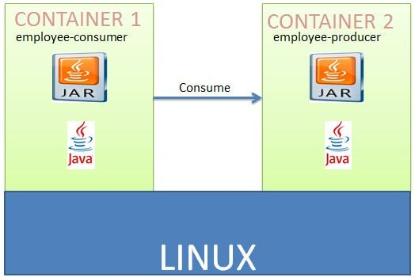
Deploy Spring Boot + MYSQL Application to Docker
Step-3
Build the docker image for the spring boot project
docker image build -t rest-jdbc .
Next run this as a container. Also we are running the container on the employee-mysql network.
docker container run --network country-mysql --name country-jdbc-container --rm -it -p 8080:8080 rest-jdbc

Slide 10
Deploy Spring Boot + MYSQL Application to Docker
Step-4
Test REST APIs
--- to add the inserted record
curl --header "Content-Type: application/json" --request POST --data '{"code":"UK","name":"Kingdom"}' http://localhost:8080/addcountry
--- to get all inserted records.
curl localhost:8080/getcountries
--- to get a specific inserted record.
curl localhost:8080/getcountries/IN

Slide 11
Docker compose
Docker Compose is a tool for defining and running multi-container Docker applications.
With Compose, you use a YAML file to configure your application's services.
Then, with a single command, you create and start all the services from your configuration.
For these , Docker-Compose tool must be installed in your OS.
$ sudo curl -L "https://github.com/docker/compose/releases/download/1.23.2/docker-compose-$(uname -s)-$(uname -m)" -o /usr/local/bin/docker-compose
Next, set the permissions to make the binary executable:
$ sudo chmod +x /usr/local/bin/docker-compose
Add it into docker group
$ sudo groupadd docker
$ sudo usermod –aG docker centos
$ groups centos
Now again lets check the docker-compose version
$ docker-compose --version

Slide 12
Docker compose
Under current 'restsql' folder , make a new folder to store db script
Here, we write table creation and data store script which will be executed when mysql container is to be started.
This script will be present under folder ‘dbsrcipt’ which is in current folder ‘restsql’
[root@centos7 restsql]# mkdir dbscript
[root@centos7 restsql]# vi dbscript/db.sql
use countrydb;
create table country (code varchar(10) not null primary key , name varchar(10));
insert into country values ('IN','India'),('US','United');

Slide 13
Docker compose
Create docker compose file
Under the folder 'restsql' , make a file as docker-compose.yml as :
[root@centos7 restsql]# cat docker-compose.yml
version: "3"
services:
rest-jdbc:
image: rest-jdbc
ports:
- "8080:8080"
networks:
- country-mysql
depends_on:
- mysqldb
mysqldb:
image: docker.io/mysql:8
networks:
- country-mysql
environment:
- MYSQL_ROOT_PASSWORD=root
- MYSQL_DATABASE=countrydb
volumes:
- ./dbscript:/docker-entrypoint-initdb.d
networks:
country-mysql:

Slide 14
Docker compose
Run the both conainers using docker compose tool as:
docker-compose up
2 applications are started... Open a new terminal , check container id.
Docker container ls
Now start mysql env :
[root@centos7 restsql]# docker container exec -it ee3054eed594 bash
mysql -uroot -proot
show databases;
use countrydb;
select * from country;
quit;
exit;
Check rest apis
--- to add the inserted record
curl --header "Content-Type: application/json"
--request POST
--data '{"code":"UK","name":"Kingdom"}' http://localhost:8080/addcountry
--- to get all inserted records.
curl localhost:8080/getcountries
--- to get a specific inserted record.
curl localhost:8080/getcountries/IN

Slide 16
Service with other service as docker containers

Slide 17
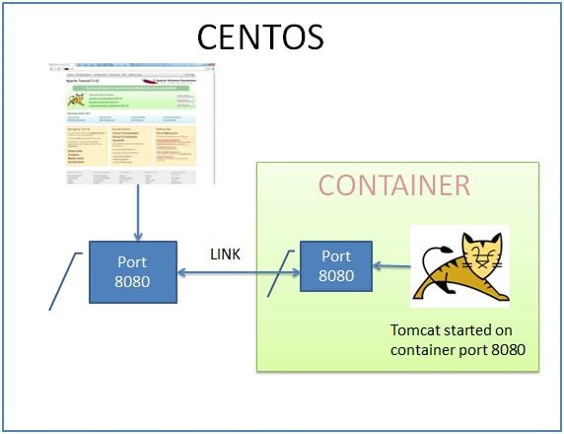
Service with other service

Slide 18
Service with other service

Slide 19
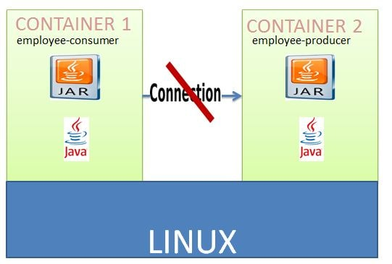
Service with other service

Slide 20
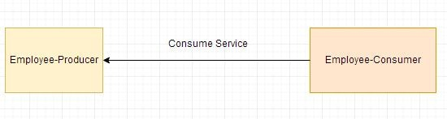
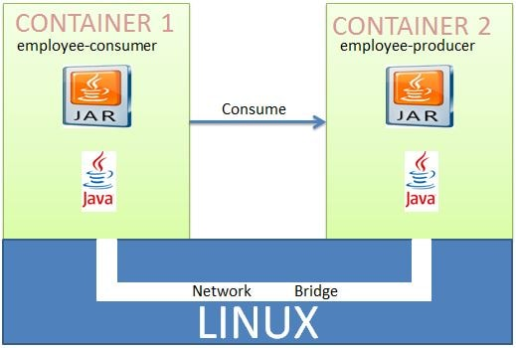
Deploying Multiple Spring Boot Microservices to Docker using Docker Networking

Slide 21
Deploying Multiple Spring Boot Microservices to Docker using Docker Networking
A Docker Container should have only a single service running.
Deploying two microservices employee-producer and employee-consumer to two different containers and then have them interact with each other.

Slide 22
Deploying Multiple Spring Boot Microservices to Docker using Docker Networking
Step-1
Make the employee-producer spring rest boot app.
Package as a jar file using maven build command.
Then Copy this jar file in linux env within a specific folder.
Under this folder , create a Docker file as :
From openjdk:8
copy ./target/employee-producer-0.0.1-SNAPSHOT.jar employee-producer-0.0.1-SNAPSHOT.jar
CMD ["java","-jar","employee-producer-0.0.1-SNAPSHOT.jar"]

Slide 23
Deploying Multiple Spring Boot Microservices to Docker using Docker Networking
Step-1
Open the terminal and start the docker
systemctl start docker
will build an image with the name producer.
docker image build -t employee-producer .
run image as a container named producer. Also publishing the docker port 8080 to centos port 8080.
docker container run --name producer -p 8080:8080 -d employee-producer
test by curl:
curl localhost:8080/employee

Slide 24
Deploying Multiple Spring Boot Microservices to Docker using Docker Networking
Step-2
Create the employee-consumer spring boot app as a client application which call rest services from previous application.
Created and started a container named producer where deployed the employee-producer service. So the only change is while consuming the employee producer service ,using this container named producer instead of localhost:8080. So in the ConsumerControllerClient class use the base url as http://producer:8080/employee instead of http://localhost:8080/employee

Slide 25
Deploying Multiple Spring Boot Microservices to Docker using Docker Networking
Step-2
public class ConsumerControllerClient {
public void getEmployee() throws RestClientException, IOException {
String baseUrl = "http://producer:8080/employee";
RestTemplate restTemplate = new RestTemplate();
ResponseEntity<String> response=null;
try{
response=restTemplate.exchange(baseUrl,HttpMethod.GET, getHeaders(),String.class);
}
catch (Exception ex) {
System.out.println(ex); }
System.out.println(response.getBody());
}
…
}

Slide 26
Deploying Multiple Spring Boot Microservices to Docker using Docker Networking
Step-2
Make jar file using maven build
Copy in linux specific foler .
Make a docker file as :
From openjdk:8
copy ./target/employee-consumer-0.0.1-SNAPSHOT.jar employee-consumer-0.0.1-SNAPSHOT.jar
CMD ["java","-jar","employee-consumer-0.0.1-SNAPSHOT.jar"]
build an image with the name consumer.
docker image build -t employee-consumer .
run the above image as a container named consumer.
docker container run --name consumer -d employee-consumer
check the logs using ------ gets error
docker container logs consumer

Slide 27
Deploying Multiple Spring Boot Microservices to Docker using Docker Networking

Slide 28


Deploying Multiple Spring Boot Microservices to Docker using Docker Networking
Inter Docker Container Communication Using Docker Networking
using Docker Networking to allow multiple containers to interact with each other.
need to create our own network and add both the employee-producer and employee-consumer services to it.
stop and remove the existing docker containers named consumer and producer.

Slide 29
Deploying Multiple Spring Boot Microservices to Docker using Docker Networking
check the available networks
docker network ls
create our own network will be of type bridge
docker network create consumer-producer
start the employee producer container on the newly created network.
docker container run --network consumer-producer --name producer -p 8080:8080 -d employee-producer
start the employee consumer+ container on the newly created network.
docker container run --network consumer-producer --name consumer -d employee-consumer
check the consumer container logs-
docker container logs consumer

